Slide 1
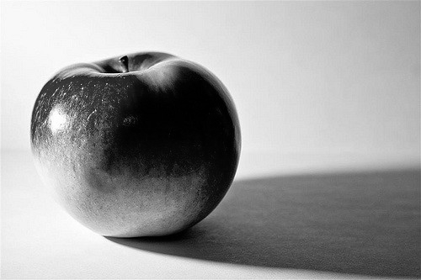
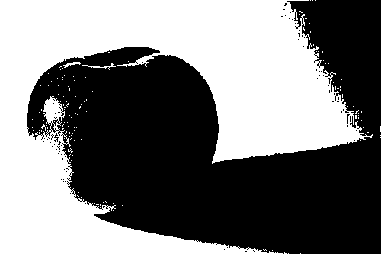
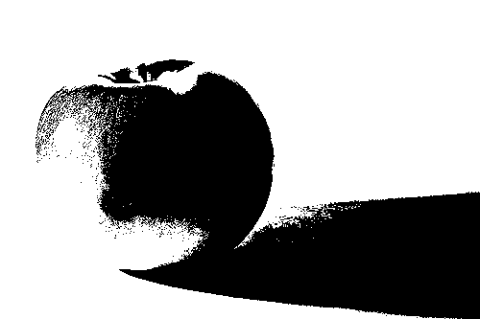
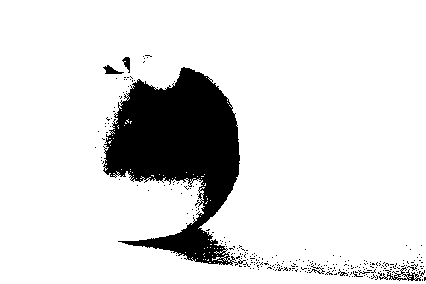
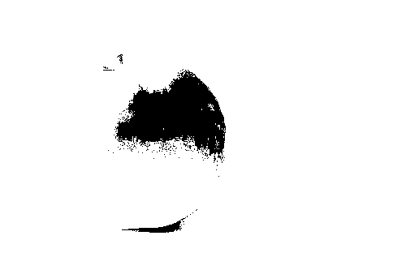
Watercolour painting basics - Apple
水彩画基础知识 - Apple
Watercolour works best when you paint from light to dark. This is the opposite of drawing. This worksheet is to help you see the different shapes of light and dark in objects. If this is your first time, simply use thin layers of the same colour. Otherwise, try going from a warm colour, like light orange, to a cool colour, like dark purple.
当你从浅到深绘画时，水彩效果最好，这与绘画相反。此工作表旨在帮助您查看物体中不同形状的明暗形状。如果这是您第一次，只需使用相同颜色的薄层即可。否则，尝试从暖色（如浅橙色）变为冷色（如深紫色）。
Paint here
在这里画画
Reference image
参考图片
1. A very thin layer of lights first
首先是一层非常薄的灯
2. Let it dry, then add light greys
让它干燥，然后添加浅灰色
3. Let that dry, then add dark greys
让它干燥，然后添加深灰色
4. Then add the darkest greys
然后添加最深的灰色

Slide 2
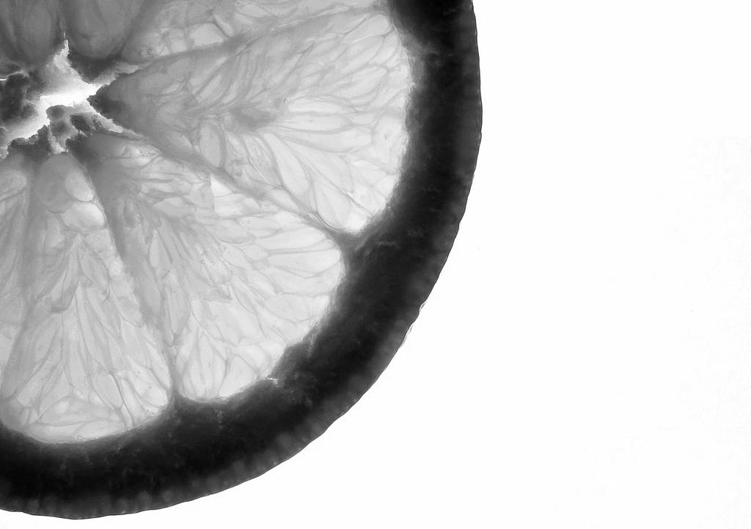
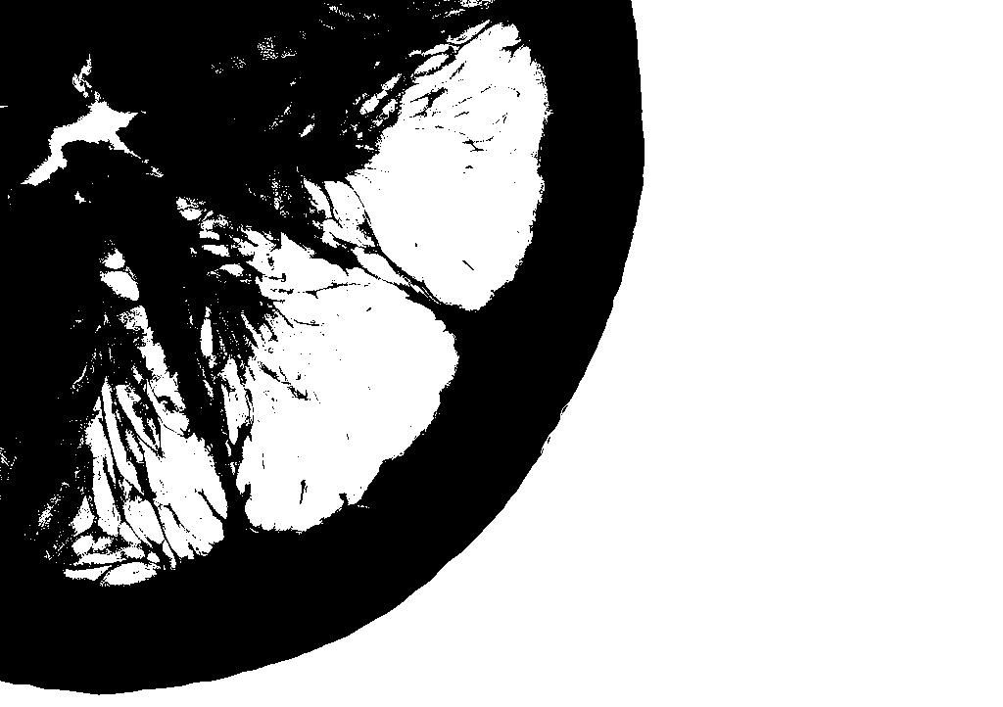
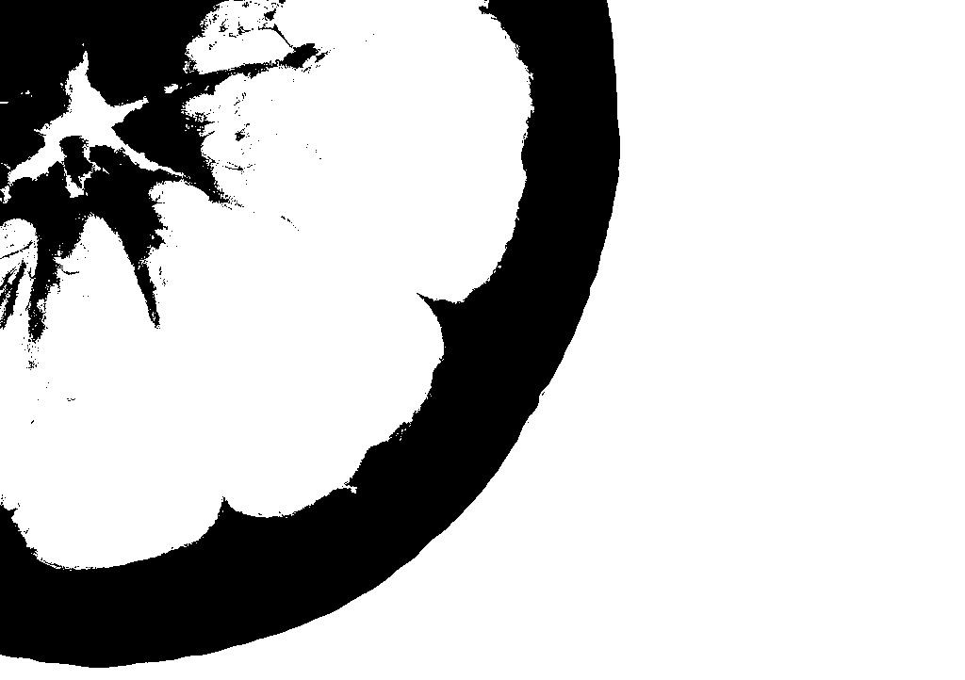


Watercolour painting basics - Orange
水彩画基础 - 橙色
Watercolour works best when you paint from light to dark. This is the opposite of drawing. This worksheet is to help you see the different shapes of light and dark in objects.If this is your first time, simply use thin layers of the same colour. Otherwise, try going from a warm colour, like light orange, to a cool colour, like dark purple.
当你从浅到深绘画时，水彩效果最好，这与绘画相反。此工作表旨在帮助您看到物体中明暗的不同形状。如果这是您第一次，只需使用相同颜色的薄层即可。否则，尝试从暖色（如浅橙色）变为冷色（如深紫色）。
Paint here
在这里画画
Reference image
参考图片
1. A very thin layer of lights first
首先是一层非常薄的灯
2. Let it dry, then add light greys
让它干燥，然后添加浅灰色
3. Let that dry, then add dark greys
让它干燥，然后添加深灰色
4. Then add the darkest greys
然后添加最深的灰色

